Slide 1

Bubble Sort
Notes:
Bubble sort is one way to sort an array of numbers. Adjacent values are swapped until the array is completely sorted. This algorithm gets its name from the way values eventually "bubble" up to their proper position in the sorted array.

Slide 2
Algorithm
1. Step through entire list, swapping adjacent values if not in order
2. Repeat from step 1 if any swaps have been made
Notes:
While stepping through the data, if two adjacent values are not in sorted order, then swap them. After a full scan of the array, repeat from step 1 if any changes have been made.
The algorithm can be used to sort a list in either ascending or descending order.

Slide 3
0
1
2
3
8
6
4
2
Notes:
Let's sort the elements of this array in ascending order.

Slide 4
First pass
0
1
2
3
8
6
4
2
0
1
2
3
6
8
4
2
0
1
2
3
6
4
8
2
Notes:
During our first pass through the array, we've swapped (8,6), (8,4), and (8,2). The value 8 has "bubbled" up to its correct position.

Slide 5
Second pass
0
1
2
3
6
4
2
8
0
1
2
3
4
6
2
8
0
1
2
3
4
2
6
8
Notes:
During our second pass, we've swapped (6,4) and (6,2). The value 6 has "bubbled" up to its correct position.

Slide 6
Third pass
0
1
2
3
4
2
6
8
0
1
2
3
2
4
6
8
0
1
2
3
2
4
6
8
Notes:
During our third pass, we've swapped (4,2). The value 4 has "bubbled" up to its correct position.

Slide 7
Fourth pass
0
1
2
3
2
4
6
8
0
1
2
3
2
4
6
8
0
1
2
3
2
4
6
8
Notes:
On this final pass through the list no swaps were made, signalling that the array has been completely sorted.

Slide 8
Pseudo Code
initialize counter
do
{
set counter to 0
iterate through entire array
if array[n] > array[n+1]
swap them
increment counter
}
while (counter > 0)
Notes:
And this is how you can implement bubble sort in C to sort an array in ascending order.
What change would you make to this pseudocode if you wanted to sort a list in descending order instead?

Slide 9
Truth in CS: Real Talk
NOBODY EVER USES BUBBLE SORT
NOBODY
NOT EVER
IT’S STUPID…
BECAUSE IT’S SO INEFFICENT
THERE IS A BETTER WAY

Slide 10
What's the worst case runtime of bubble sort?
What's the best case runtime of bubble sort?
Notes:
Bubble sort is O(n²) in the worst case (numbers start out in descending order, as in the example we just saw) because we must take n steps on each of n iterations through the numbers. The largest number bubbles up to its correct place in the first iteration, the second largest in the second iteration, and so on.
Bubble sort is Ω(n) in the best case, which occurs when the list is already sorted. There will be no swaps on the first pass through the list, so the algorithm will have completed after only n comparisons.
What would the best case runtime of bubble sort be if we didn't optimize by keeping track of the number of swaps that were made?
n²

Slide 11
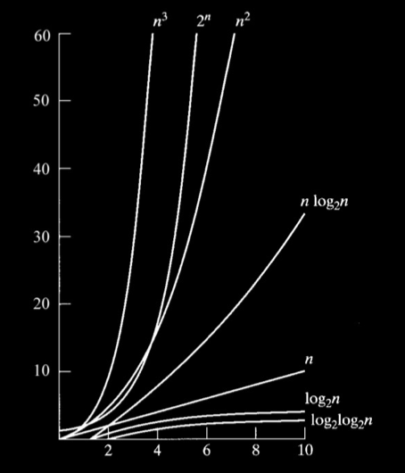
Notes:
As you can see, O(n²) is far from efficient. Maybe we can do better with other sorting algorithms?

Slide 12
Bubble Sort
Selection Sort
Insertion Sort
Merge Sort
O
n²
n²
n²
nlogn
Ω
n
n²
n
nlogn
Θ
n²
nlogn
Notes:
Here's a comparison of the runtimes of bubble sort to the runtimes of other sorting algorithms covered in CS50.

